Slide 1
Video Analytics in OpenCV
Presented by Roland Gavrilescu (@Roland)

Slide 2
Contents
Getting Started: Images and Videos
Formats and Conversions
Thresholds and Image Histograms
High-pass and Low-pass Filters
Blurring Techniques
Contours
Final Project: GrabCut Algorithm

Slide 3

Images and Videos

Slide 4
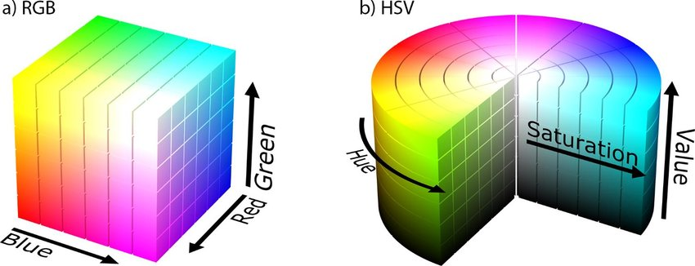
Color Models

Slide 5
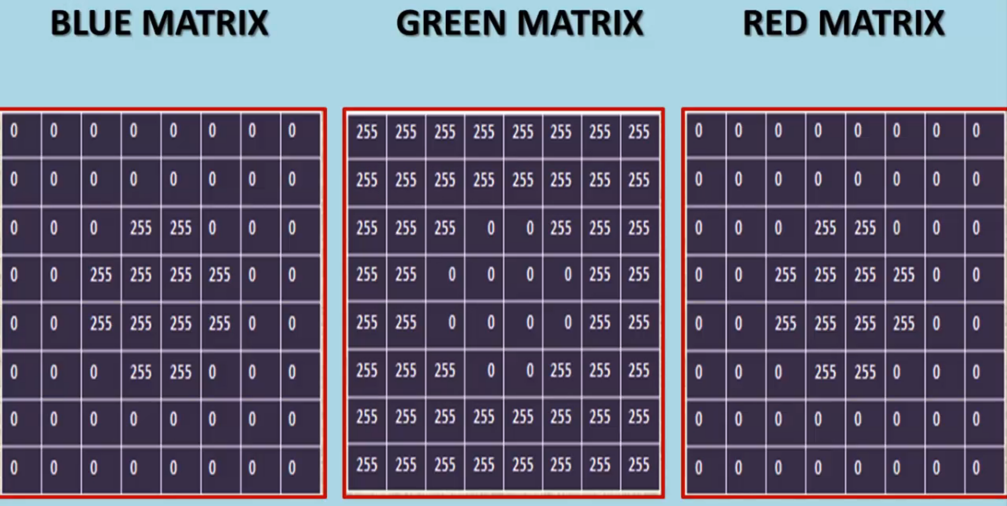
BRG (Open CV default)

Slide 6
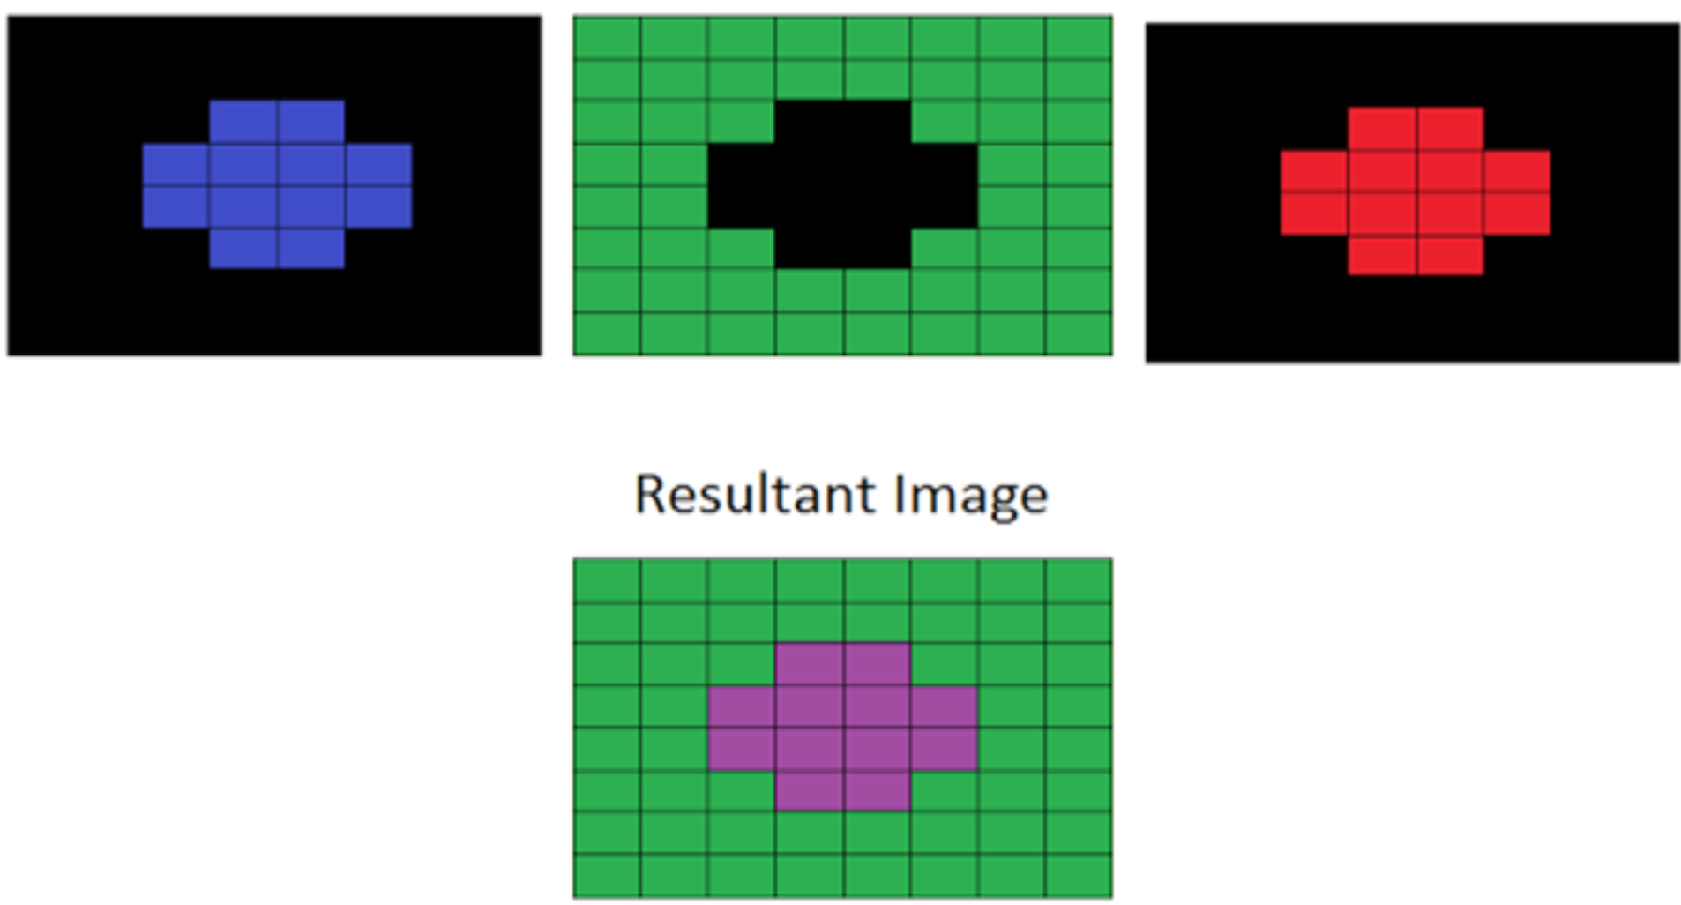
BRG (Open CV default)

Slide 7
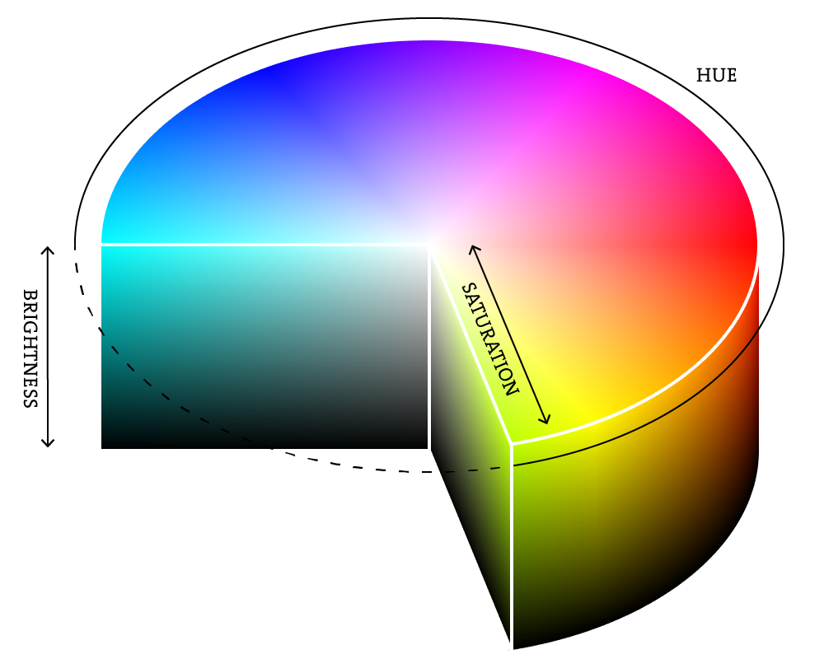
HSV (HUE, SAT, VAL)

Slide 8
Color Tracking

Slide 9

Image Thresholding

Slide 10
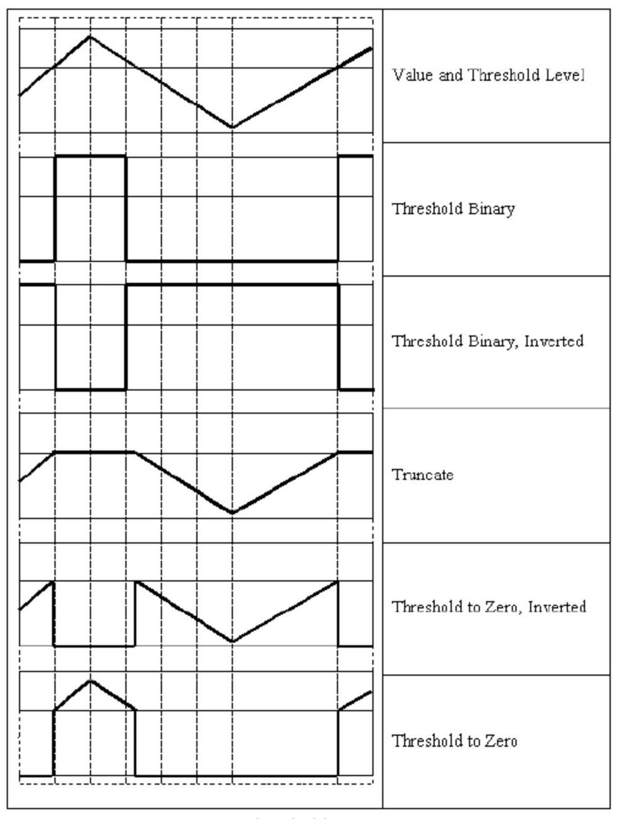
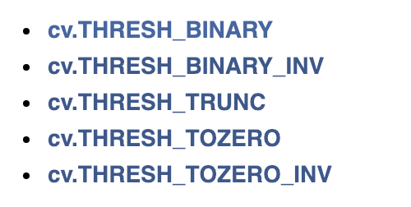
Global Thresholds

Slide 11
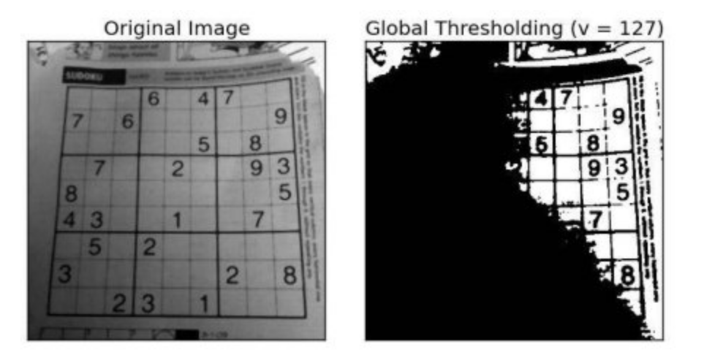
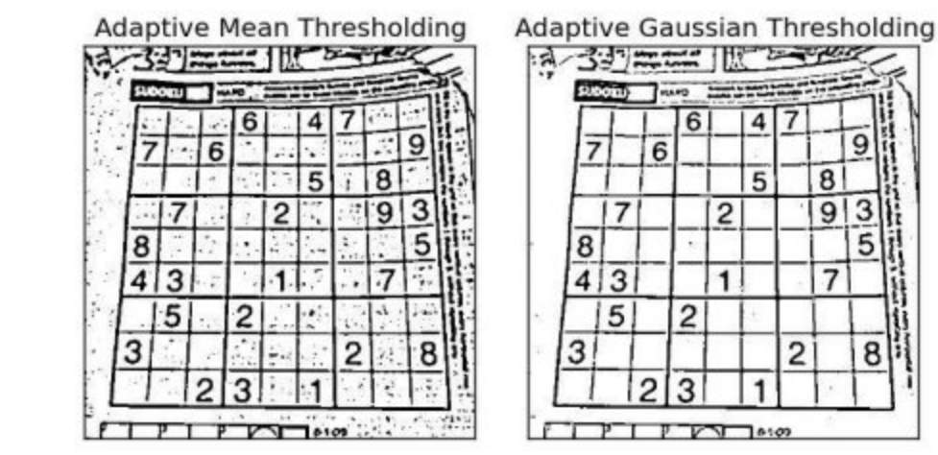
Adaptive Thresholds

Slide 12
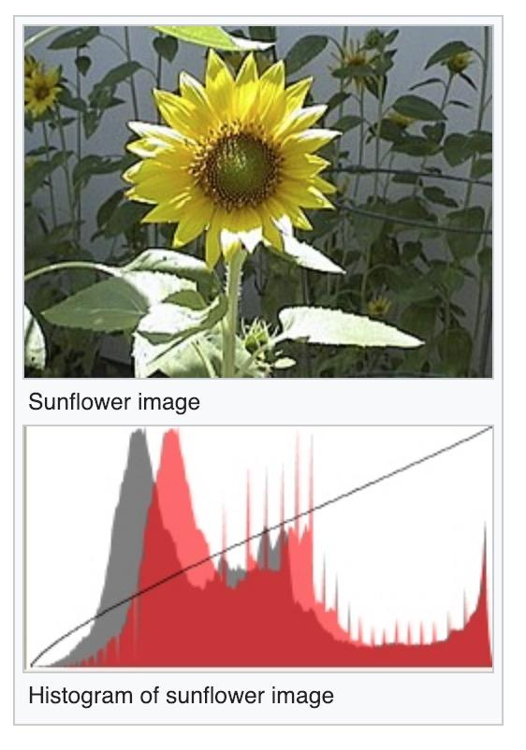
Image Histogram
Tonal distribution in a digital image
Plots number of pixels for each tonal value

Slide 13
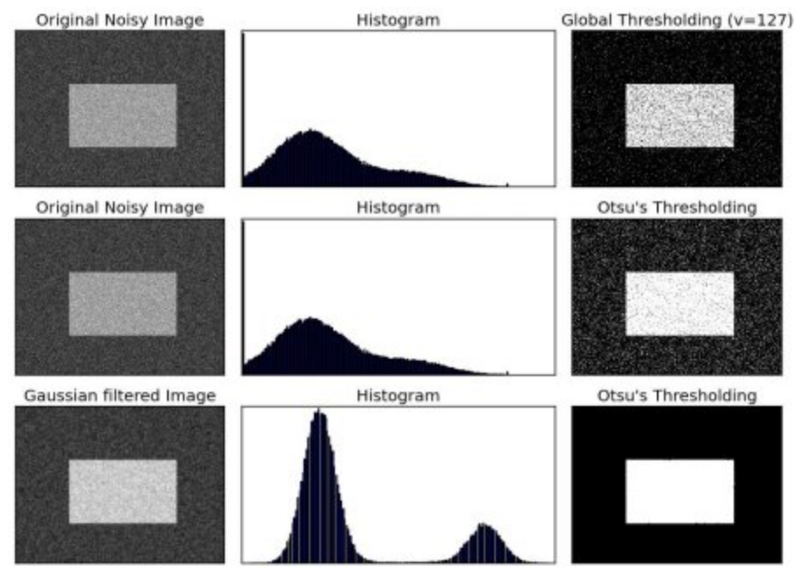
Otsu’s Binarization

Slide 14
Thresholding

Slide 15
Filters
Low-Pass Filters: used for bluring images
High-Pass Filters: used for edge detection / feature extraction

Slide 16
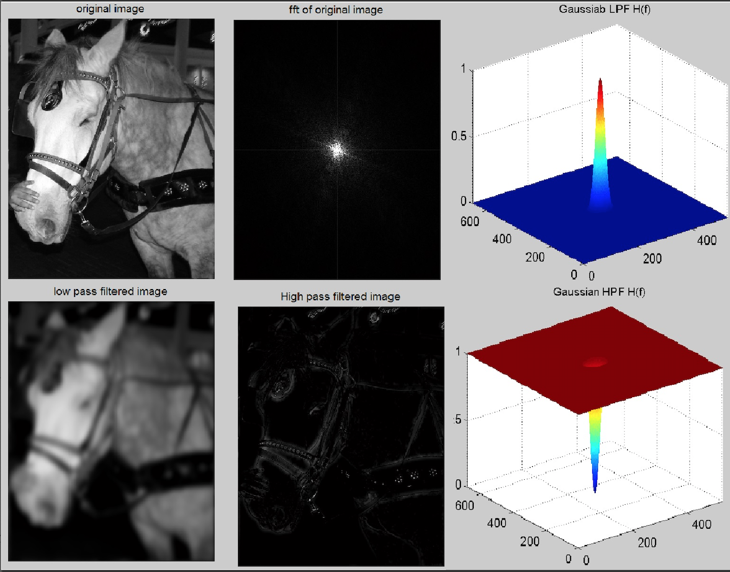

Slide 17
Smooth

Slide 18
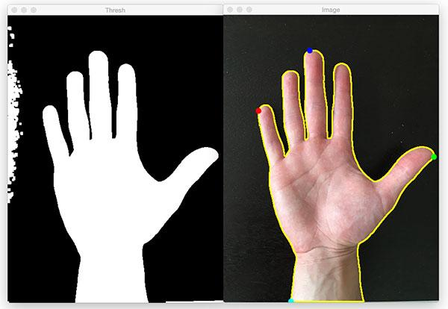
Contours
For better accuracy, use binary images. So before finding contours, apply threshold or canny edge detection
In OpenCV, finding contours is like finding white object from black background

Slide 19
Contours

Slide 20
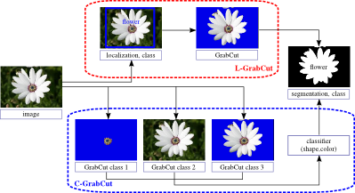
GrabCut Algorithm

Slide 21
GrabCut Algorithm

Slide 22
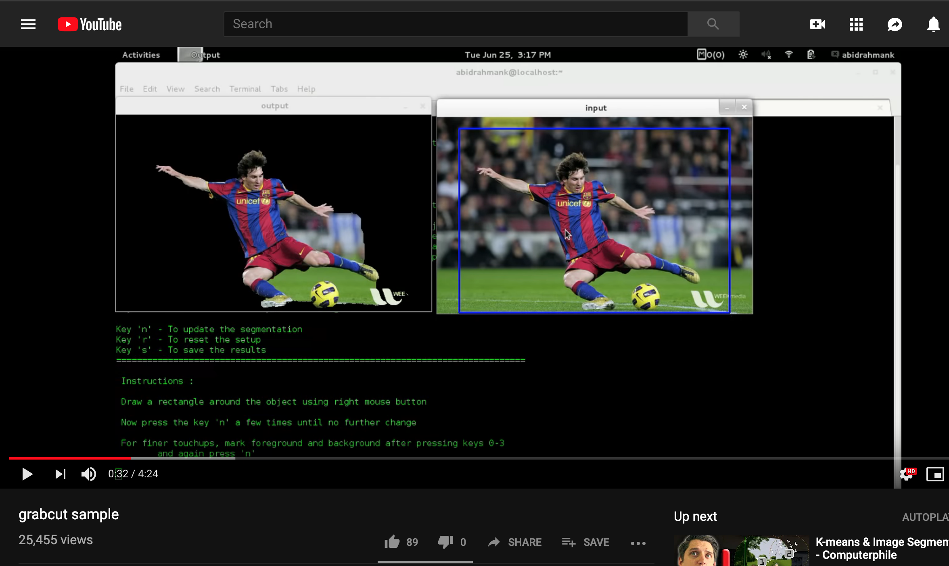
Advanced GrabCut

Slide 23
Thanks for Tuning In :)

